Slide 1
1. Introduction to Programming and C++
- Shivam Malhotra
Notes:
We designed this template so that each member of the project team has a set of slides with its own theme where he/she can present their research. Members, here’s how you add a new slide to just your set:
Mark where you want to add the slide: Select an existing one in the Thumbnails pane, click the New Slide button, then choose a layout.
The new slide gets the same theme as the previous one you selected.
Careful! Don’t annoy your fellow presenters by accidentally changing their themes. That can happen if you choose a theme Variant from the Design tab, which changes all of the slides in your presentation to that look.

Slide 2
Computer programming
Programming is the process of developing and implementing sets of instructions to enable a computer to do a certain task.^{[1]}
We use programming languages to code this instruction set.

Slide 3
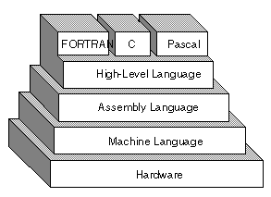
What language do computers understand?
The system can only understand and execute instructions in machine language, that is the language of 0s and 1s.
Programmers like us find it very difficult to code in machine language, hence high-level languages (HLL) like python and java were developed which are closer to our own spoken languages.
Hence programmers often use high-level languages to write their programs, which are then converted to machine language for the computer to understand and run.
Image taken from [3]

Slide 4
High Level Language (HLL) vs Low Level Language (LLL) ^{[2]}
Programming languages can be very broadly categorized into two types : HLL and LLL
High level languages are closer to human languages whereas low level languages are closer to the system hardware.
System cannot understand programs written in HLLs.
High-level languages are relatively easier to learn.
Java and Python are examples of HLL whereas Assembly language and Machine language are LLL.

Slide 5
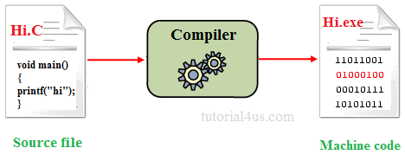
Compilers
Compiler is a program that is used to convert instructions from HLL into machine code or LLL so that they can be read and executed by a computer.
Image taken from [5]
If the compiler finds mistakes in your code, it gives errors. We will study more about errors later.

Slide 6

C++
C++ was developed by Bjarne Stroustrup in 1979 at Bell Labs
C++ was named so because it was an extension to the then existing language C. We will learn more about the ‘++’ operator later.
C++ is a compiler based language.
C++ is somewhere between a HLL and LLL, because it has features of both types.
Image taken from [4]

Slide 7

Running your programs
Once you write your programs in C++, you first need to compile them and then execute them.
There are softwares called IDEs or Integrated Development Environment like Turbo C++ which help you perform all these steps very easily.
There are multiple tutorials on Youtube on how to install Turbo C++.
Image taken from [6]

Slide 8
Assignment
Before going any further, install Turbo C++ and try to compile and run the following program. We will understand what it does in the next video.
// My First Program
#include <iostream.h>
int main()
{
cout << "Hello World";
return 0;
}

Slide 9
Sources
[1] http://www.businessdictionary.com/definition/computer-programming.html
[2] http://iamcomputerexpert.blogspot.in/2008/09/difference-between-low-level-high-level.html
[3] http://www.webopedia.com/TERM/H/high_level_language.html
[4]http://assets4.bigthink.com/system/user_icons/82621/original/BStroustrup_MAIN.jpg?1282857509
[5] http://www.sitesbay.com/cprogramming/images/c-compiling.png
[6] http://2.bp.blogspot.com/-HfpDRVM32E0/VQLyvuu7sbI/AAAAAAAABC8/ZM2MgYJ5NSc/s1600/turbo.png

